Slide 1
MySQL
Day 03
Important DML Commands and Functions in MySQL

Slide 2
CRUD
CRUD is an acronym that stands for Create, Read, Update & Delete.
Create : Used to add new records to a database using INSERT statement. We have seen this in Day 02 presentation.
Read : Used to retrieve data from a database using SELECT statement.
Update : Used to Modify existing records in a database using UPDATE statement.
Delete : Used to remove records from a database using DELETE statement.
These functions make up basic set of operations that are used to manage data in a MySQL database.

Slide 3
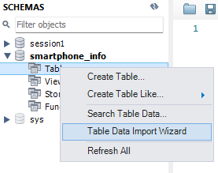
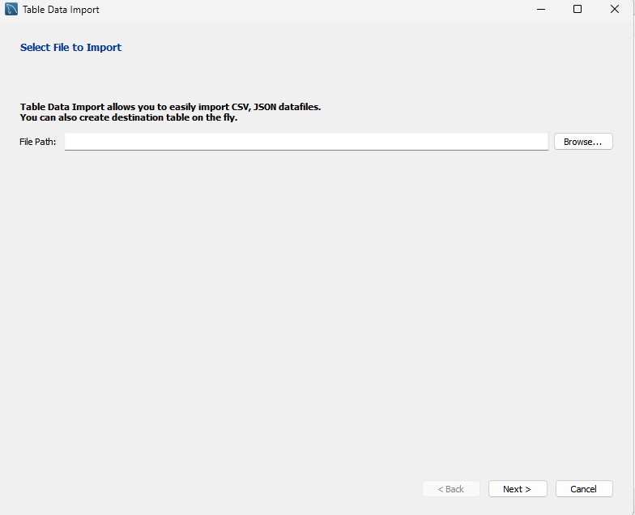
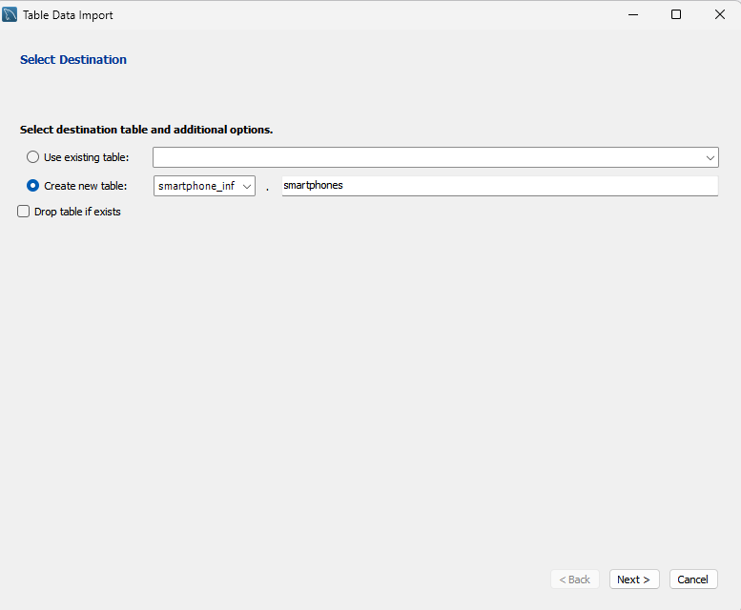
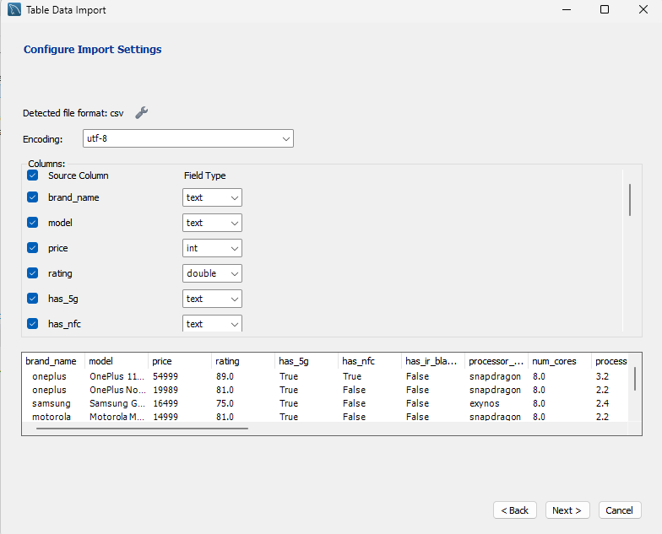
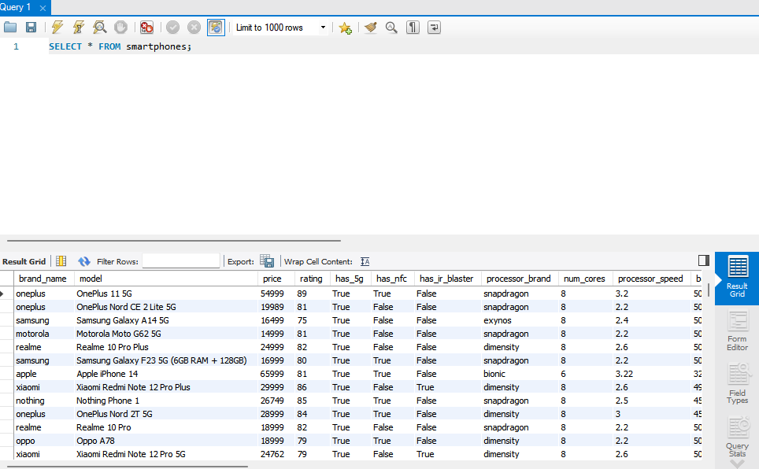
IMPORTING DATA
We will import a .csv file in our newly created database in MySQL, and work on it throughout this presentation.
1
2
3
Right Click on Tables.
Select Table Data Import Wizard
Provide Path to your file.
Click Next
Create a New Table
Click Next
Check Data Type
Click Next.
Click Next
Click Finish
Check if the file is loaded with the help of SELECT Command
Refer to the images.
Follow the exact steps in the learning process.
5
4

Slide 4
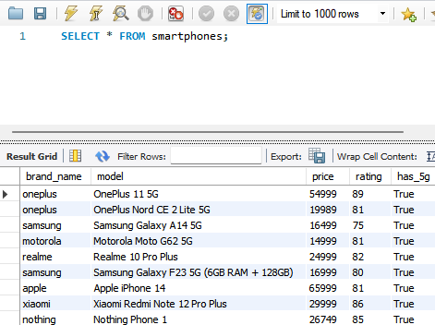
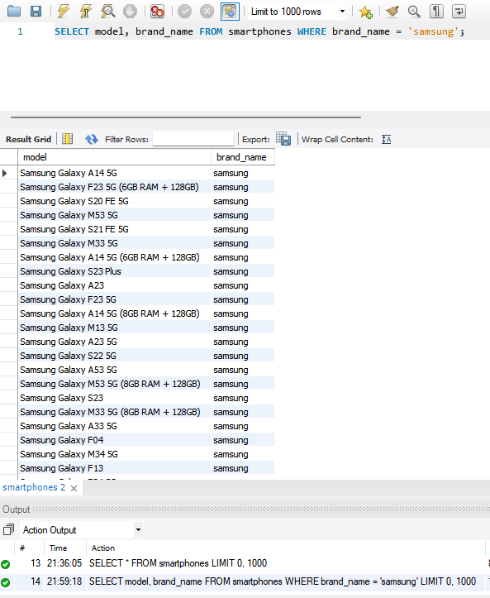
SELECT
The SELECT statement is used to retrieve data from one or more tables in a MySQL database and is the most commonly used statement used for a wide range of purposes, from simple data retrieval to complex queries that involve multiple tables & advanced filtering.
Basic Syntax : SELECT column1, column2, ... FROM table_name WHERE condition;
SELECT * >> retrieve all data
Using WHERE Condition to retrieve data that we need from whole table.

Slide 5
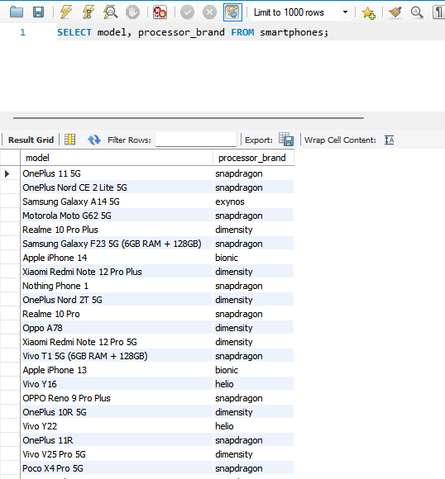
FILTERING COLUMNS
Filtering columns in MySQL involves selecting only specific columns from a table instead of retrieving all columns.
To filter columns in MySQL , we use SELECT statement with comma-separated list of columns we want to retrieve.
In the image, We have filtered columns with column names ‘model’ and ‘processor_brand’ from the whole table on which we can work as per the requirement. Note that the order of mentioning the column name matters as MySQL workbench will display content as per the order mentioned.

Slide 6
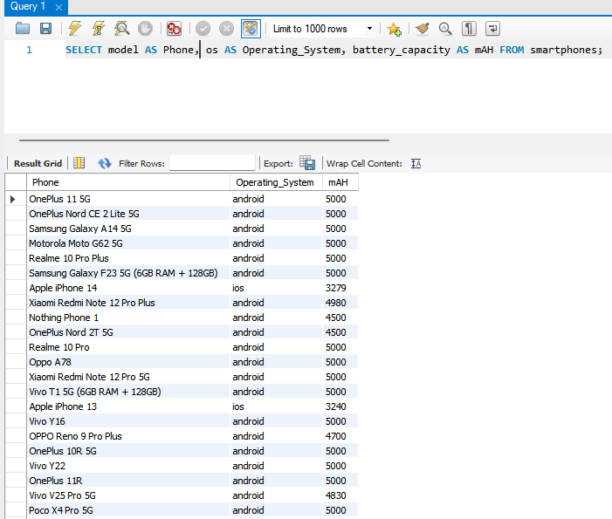
ALIAS
Alias in MySQL is a way to rename a table or a column in a SQL query.
We use ‘AS’ keyword to create an alias in MySQL.
Using aliases can make it easier to write complex queries and make them more readable.
In the image, We have renamed the columns ‘model’,’ os’ & ‘battery_capacity’ AS ‘Phone’, ’Operating_System’ & ‘mAH’ respectively, using AS keyword and SELECT statement in MySQL Workbench. It definitely makes us understand the columns in a better way and thus making it more readable.

Slide 7
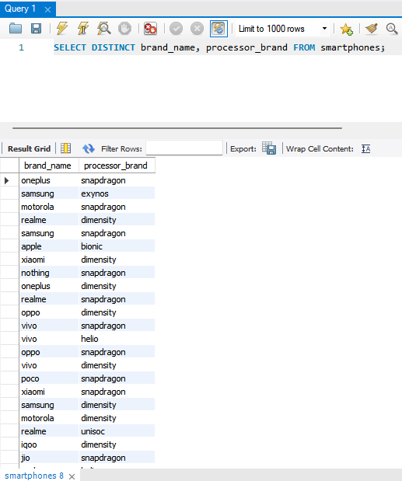
DISTINCT
DISTINCT keyword is used to retrieve only the unique values of a column.
Can be used to remove duplicates from the result set & simplify data analysis.
Can be used for retrieving unique combinations in the table of a database.
In the image, We have used DISTINCT keyword in the SELECT statement to retrieve the unique combinations of ‘brand_name’ and ‘processor_brand’ from ‘smartphones’ table. Similarly, we can do it for a single column as well and get rid of the duplicates that will definitely simplify the data analysis.

Slide 8
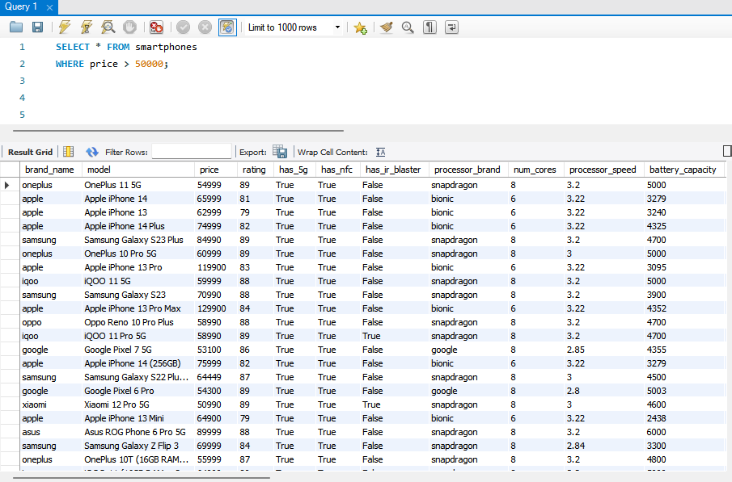
WHERE
WHERE clause is used in SELECT, UPDATE, or, DELETE statement to filter out rows by specifying a condition.
WHERE clause can use logical operators such as AND, OR, and NOT to combine multiple conditions.
WHERE clause can also use various functions such as LIKE, IN, and BETWEEN to perform more complex comparisons.
Overall, the WHERE clause is a powerful tool in MySQL for filtering data & retrieving only the rows that meet specific conditions.
In the image, we have used a simple condition to demonstrate the use of WHERE clause with SELECT statement in MySQL.
We wanted to find all the smartphones that are priced more than 50,000.
We simply used the WHERE clause, and provided with the condition, and you can see in the output that all the phones that meet our condition is displayed.

Slide 9
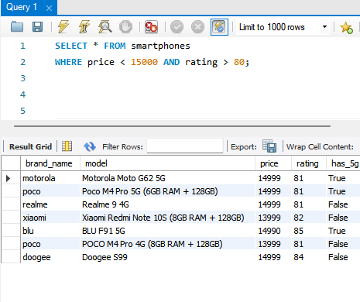
AND
AND is a logical operator used to combine two or more conditions in WHERE clause.
AND operator requires both the conditions to be true in order for a row to be selected.
Overall, AND operator is a powerful tool in MySQL for combining multiple conditions in a WHERE clause to filter data & retrieve only the rows that meet all of the conditions.
In the image, we have a simple demonstration of how to use AND operator. We wanted to find all the phones with rating more than 80 and price less than 15000. We simply use AND operator between the conditions in the WHERE clause and get the required data from the massive dataset.

Slide 10
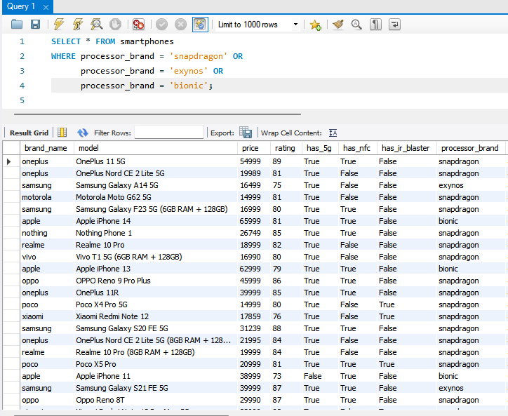
OR
OR is a logical operator used to combine two or more conditions in WHERE clause.
OR operator requires at least one of the conditions to be true in order for a row to be selected.
Overall, OR operator is a powerful tool in MySQL for combining multiple conditions in a WHERE clause to filter data & retrieve only the rows that meet at least one of the required conditions.
In the image, we have a simple demonstration of how to use OR operator. We wanted to find all the phones processor brand ‘snapdragon’, ‘exynos’, and ‘bionic’. We simply use OR operator between the conditions in the WHERE clause and get the required data from the massive dataset.

Slide 11
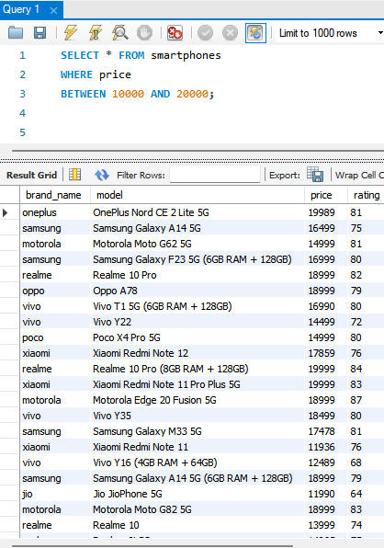
BETWEEN
BETWEEN operator is a convenient way to filter rows based on a range of values and used in WHERE clause.
BETWEEN operator can be used with any data type that supports comparison operations.
BETWEEN operator includes both the lower & upper bounds of the range.
In the image, We wanted to see all the phones between the price range of 10000 and 20000. We simply use BETWEEN operator in WHERE clause and filter the relevant rows and our required rows get displayed in the output.

Slide 12
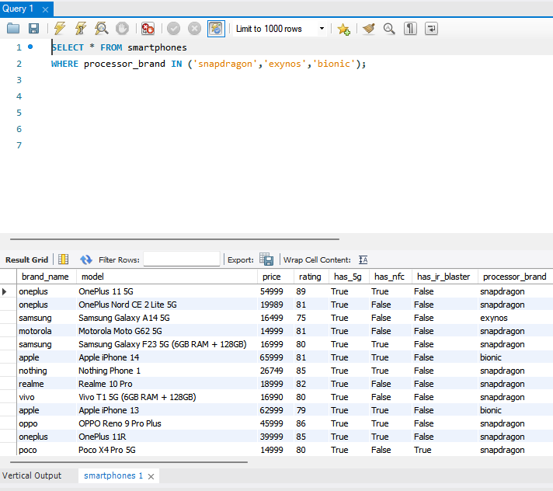
IN and NOT IN
IN and NOT IN operators are used to filter rows based on the list of values and generally used in WHERE clause.
IN is used to filter rows that matches the values needed.
NOT IN is used to filter rows that does not matches the values provided.
In the image, We wanted all phones that has processor_brand ‘snapdragon’, ‘bionic’ and ‘exynos’. We could have used OR in the WHERE clause. But we chosed to use IN operator in WHERE clause to make our code more readable and get the desired output. Similarly, NOT IN will exclude any values provided within the parenthesis.

Slide 13
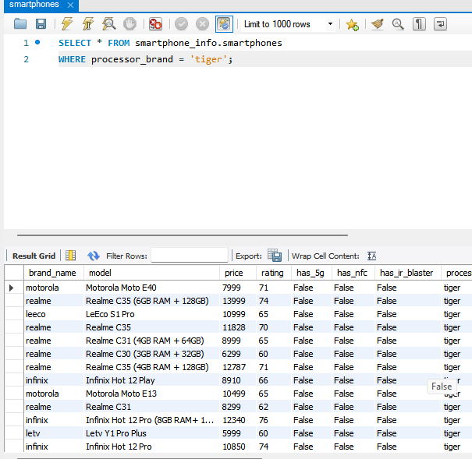
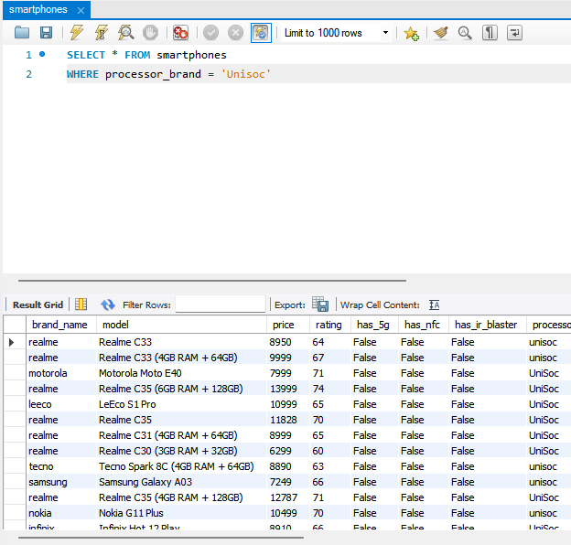
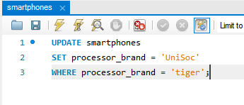
UPDATE
UPDATE statement is used to modify existing records in the table.
It allows us to update one or more columns of one or more rows based on the condition specified.
Syntax : UPDATE table_name SET column1 = value1, column2 = value2,… WHERE condition;
Be careful while using UPDATE statement, as it modifies multiple rows at once if we don’t specify condition in WHERE clause
1
In the image, We wanted to update every processor_brand by name tiger to Unisoc. We did it by using UPDATE as in image 2. You can compare the result (img 3) and image 1 for the changes done.
3
2

Slide 14
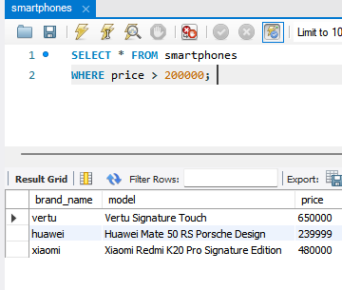
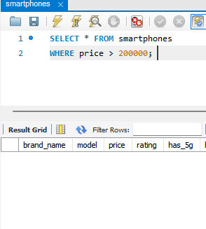
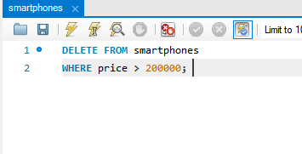
DELETE
DELETE statement is used to delete one more rows from a table.
Allows us to remove specific records based on the specified condition.
Syntax : DELETE FROM table_name WHERE condition;
Be careful while using DELETE statement, as it may permanently remove the data from the database.
We want to delete rows that contain phones priced more than 200000.
Img 1: We have 3 phones priced more than 200000
Img 2: We used DELETE statement to delete those 3 records.
Img 3: We cross check, and the records are deleted.
1
3
2

Slide 15
FUNCTIONS
MySQL has built-in and user defined functions that we can use in SQL statements to perform variety of operations easily. Some of the types of Built-In functions in MySQL are as follows.
Aggregate Functions:
Perform a calculation on set of values & return a single value as the result. Functions include COUNT, SUM, AVG, MIN & MAX
String Functions:
Manipulate character strings & return new string as a result. Functions Include CONCAT, LENGTH, SUBSTRING & REPLACE.
Date and Time Functions:
Manipulate Dates & Times & return new dates & times. Functions include NOW, YEAR, MONTH, DAY, HOUR, MINUTE & SECOND.
Control Flow Functions:
Allows to control the flow of executing in SQL statements. Includes IF, CASE and COALESCE.
Mathematical Functions:
Perform mathematical operations on numeric value & return a single value as a result. Includes ABS, CEIL, FLOOR, ROUND & RAND.
Miscellaneous Functions:
Returns information about the database or user. Includes SESSION_USER, DATABASE, VERSION & USER.
These functions can be used in various SQL statements such as SELECT, WHERE, GROUP BY, HAVING, ORDER BY and JOIN to perform different types of operations on data stored in a MySQL database.
The PDF file of all these functions is uploaded in the GitHub repository. Link is in the conclusion slide.

Slide 16
Conclusion
We have seen some of the DML commands in this slide which are most used in MySQL for Data Analysis.
We have also learned very briefly what functions are .
Find all the slide in the GitHub Repository by visiting the link below.
https://github.com/rahulpal-1991/Refresh-MySQL-Skills-in-7-Days

